Slide 1
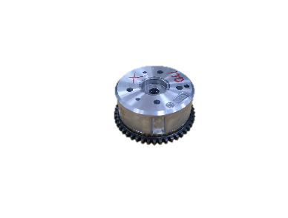
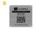




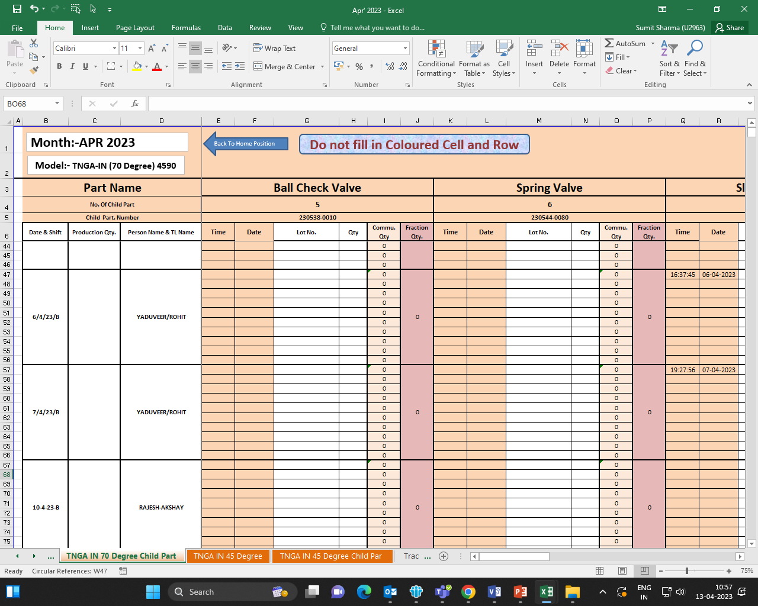

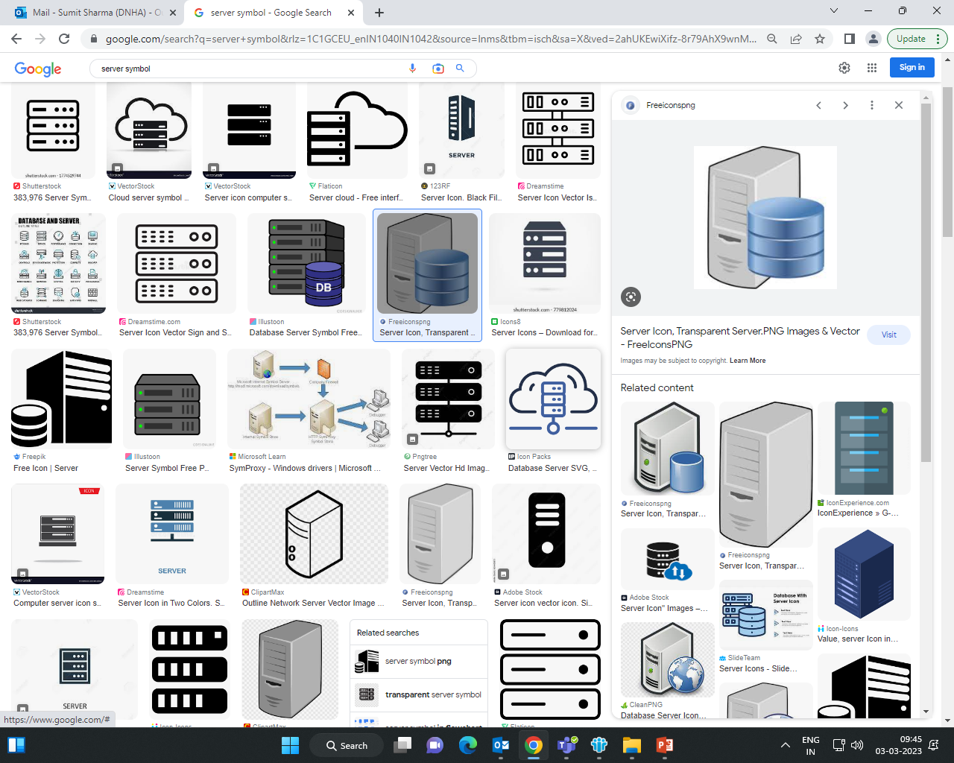
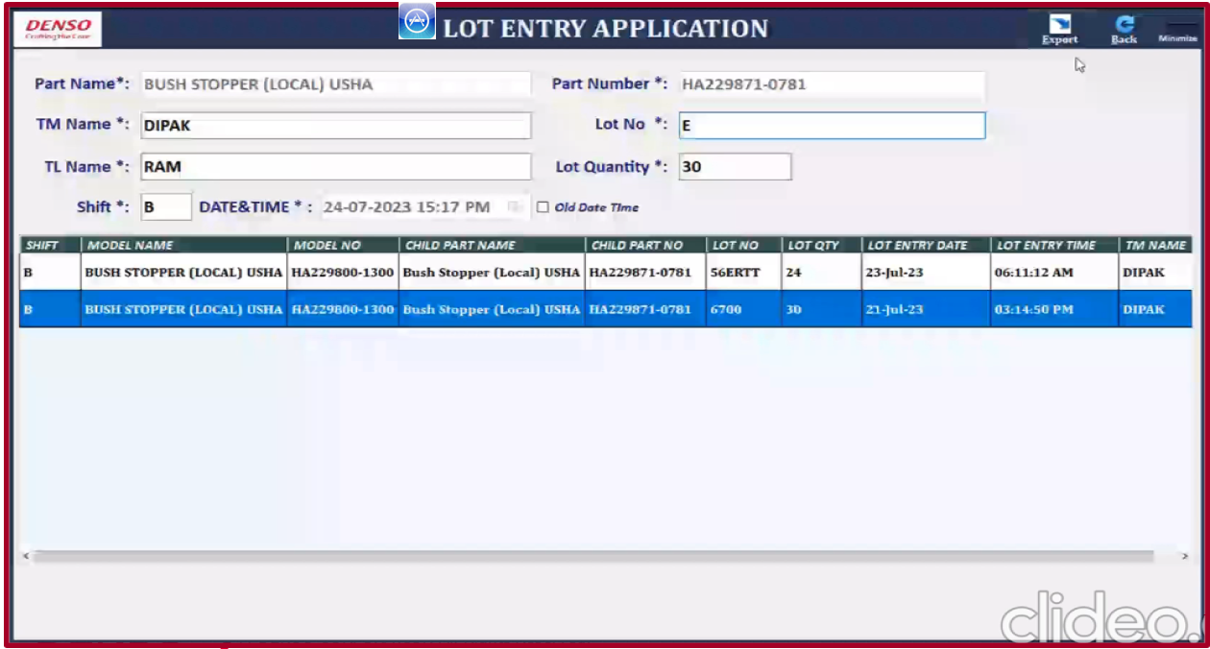
VCT Line 2 Washing mc entry (Step 1)
Washing mc
(Lot entry)
Assy
Line
Performance mc (FG S/n)
=
Child parts
Washed parts
Parallel design ongoing (4th Aug Demo plan)
Scheduler
Traceability Dashboard Features
Trace Back ward → FG S/n to suspected lot
Trace Forward → Suspected lot to FG S/N
(Quantity and Time base logic)
Make new
Lot entry app
Explain Today
dB
X
From existing excel can not fetch data
Traceability PC

Slide 2
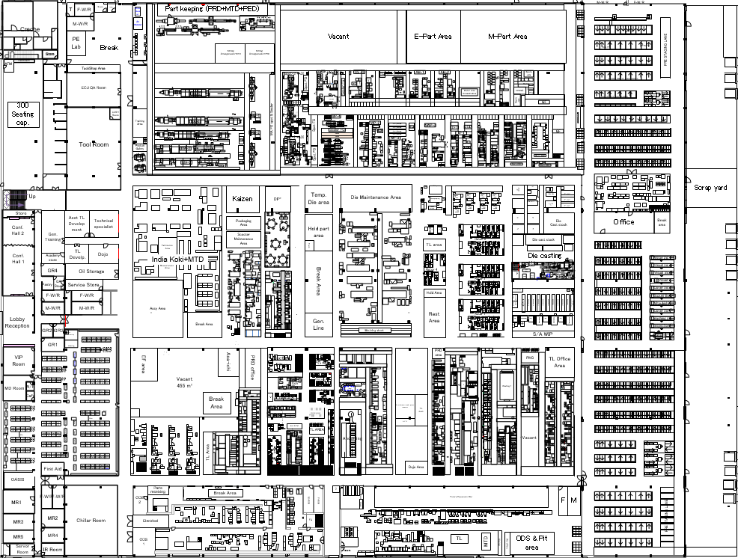
VCT Line 2 Step 2 open item in specifications
Rotor 4 line
Hsg 5 lines
Idea 1 → Send all IN-house mcg FG to W/H under Jai san PC to print std QR label (Mizumashi loss)
Idea 2 → For IN house bin,fix permanent QR code & use (data map erase –plant 2 concept)
(All bins are common for L1 also, difficult to control)
Idea 3 → Use existing lot card paper system for IN house mcng & provide manual + QR code entry in washing mc . (Non std job for operator)
Idea 4 → Setup label printers & consider cost
(some lines outsource ,investment ok?)
Total label printer need (if setup FG station) → 9
Cost = 1.4 Mill INR (0.15/printer cost include small PC)
Rotor
Hsg
Wash
VCT L2

Slide 3

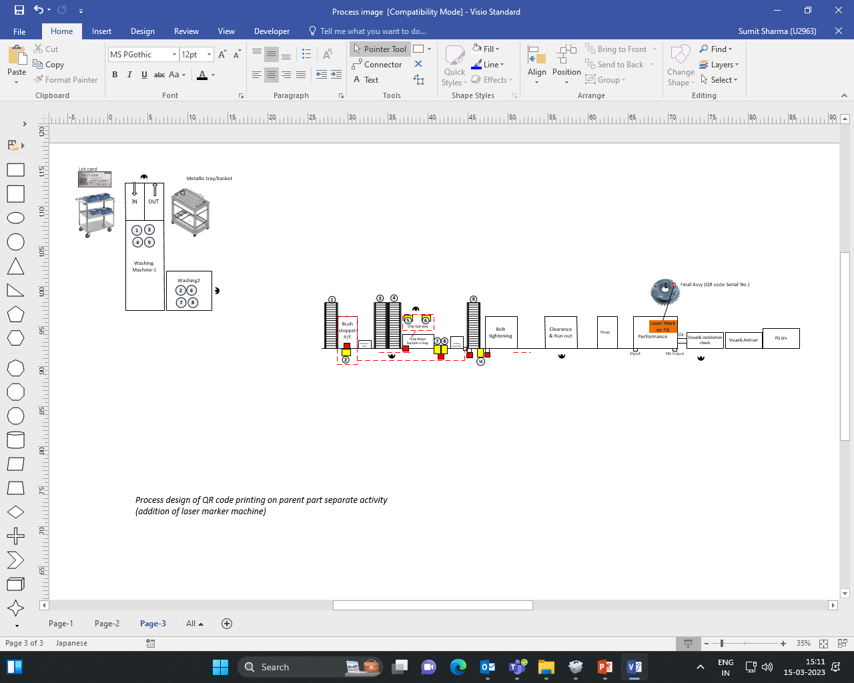
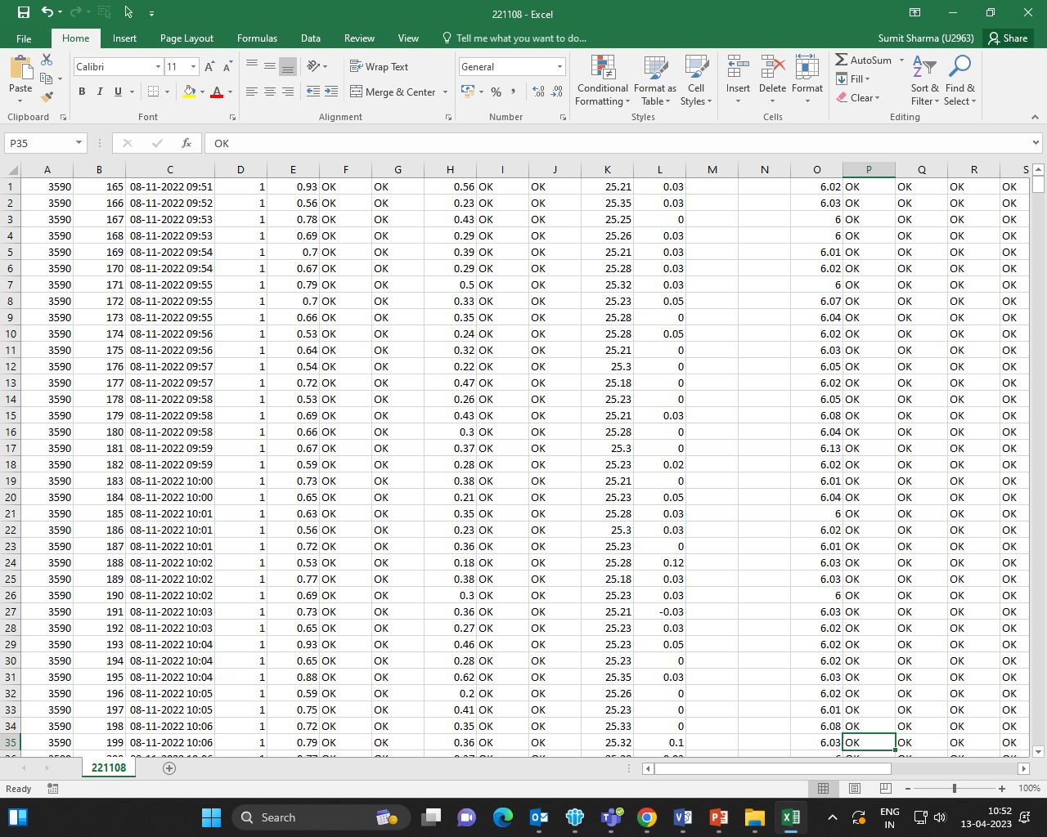
Step 1→ Digitization of existing traceability
Supplier
Manual Entry
Traceability
application
Receiving child part
Washing
Key job → Software dashboard design, how to get data from Washing & performance mc
Performance mc
Assembly
O/P → Trace time level up, Lv4
Trace unit level same,Lv3
FG staging
Customer
Washing
Assembly
210023
Basic logic to search suspected lot → Quantity base.
If part made at station no. 2 → total qty (Q) = 2N+1
If part made at station no. 1 → Total qty (Q) = 2N-1
(In performance mc,n=2 stations)
Net quantity washed (W)= Q + Rejection (take out from line) till that time + Desiccator part Q
(PRD to enter hourly quantity in dB.) There will be n=2 rejection entries (Min. & maximum if defected part) produced in b/w any hours.
W qty shall be searched in washing excel row wise, after system search ends based on minimum and maximum rejection quantity ,system will show related lot number judge as NG

Slide 4
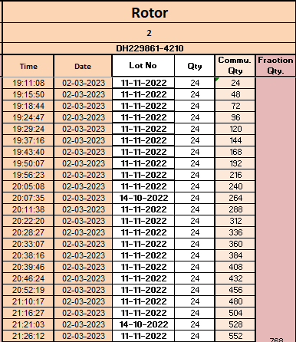
Total ok assy qty (Q) = 2N+1 if part made at station no. 2
If part made at station no. 1 → Q = 2N-1
N will be get from Performance mc csv. /direct part no. entry.
W= Q+ R
Rejection qty , H1 ~ H8 (from PRD hourly sheet input data)
Washing machine data
New W will be subtracted from lot entry and search stop when total W ends.
Start from 1st row
Stop
Suspected lot
Backward Trace ➔ Suspected lot is identified
Forward trace➔ Trace Assy S/N with respect to suspected lot . (as Per FIFO & rejection info)

Slide 5
Calender
Model
Child part
S/N (add all 6 digits
Rejection Qty on that day
Suspected Lot
Tracebackward

Slide 6
Calender
Model
Child part
Rejection Qty on that day
S/N
Suspected Assy (FG)
TraceForward
S/N 40 ~ 45
S/N 55

Slide 7


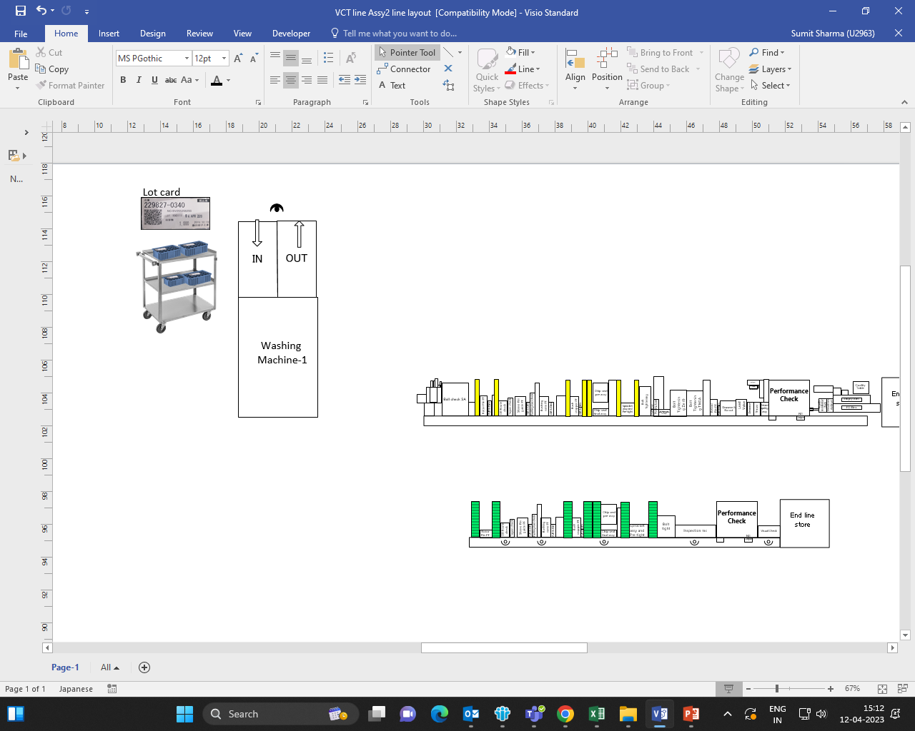
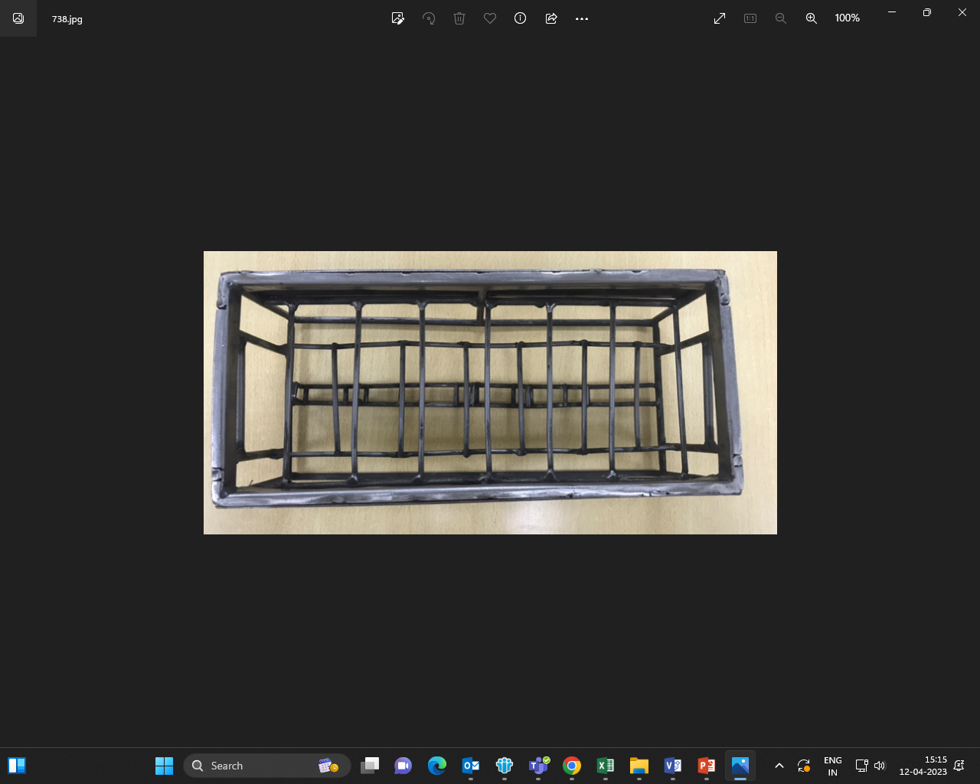
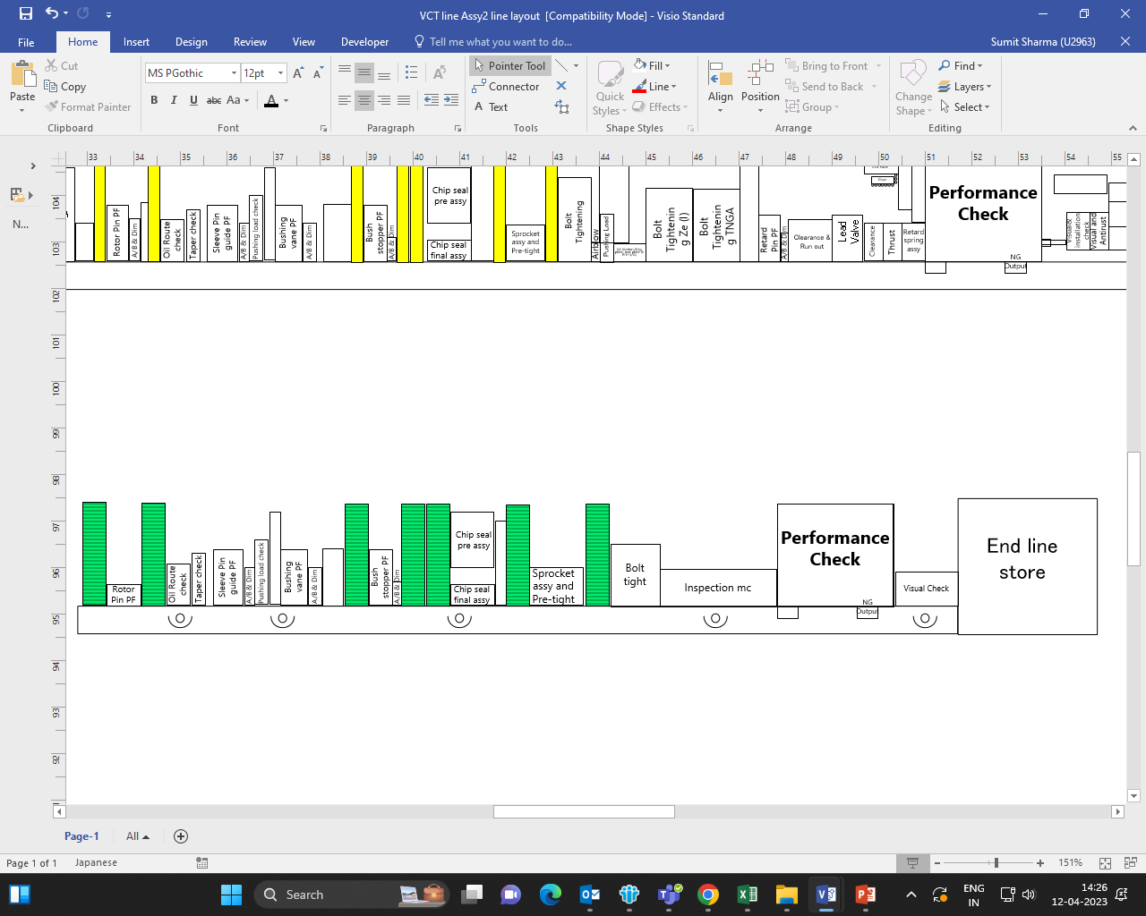
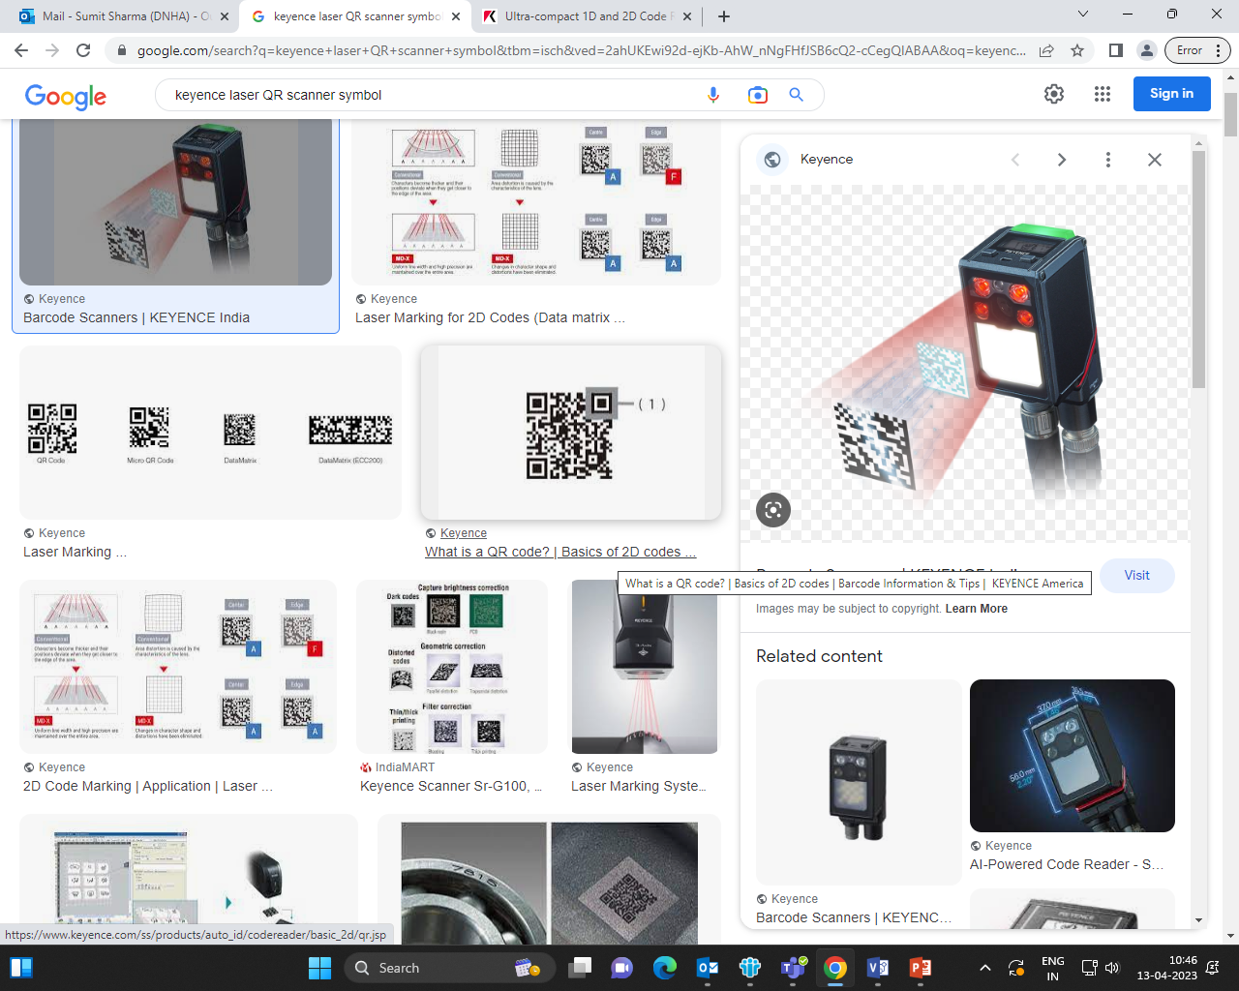
Step 2→ Remove Washing mc manual entry to scanning lot QR
Key job → Development of QR code on all child parts lot card
(IN house & outside)
Applicable scope → All child parts, all models (n=9 model on L2)
Lot card
Software
(Server)
Find in software Trace suspected lot from dB time base
Assy S/N from Performance mc sent to dB
Washing
Assembly
Step 3→ Lot info at assy line
Traceability
application
Lot card
QR code
Lot data linking w/child part tray
Software
(Server)
Child part Tray QR code
Applicable scope → Big child parts of all models, supply to line in washing trays (n=9 model on L2)
Tray supply to line
Basic logic → Time base
C1
C2
Process flow
C3
C4
C5
C6
C7
Tray QR code
scanner
Assembly line

Slide 8
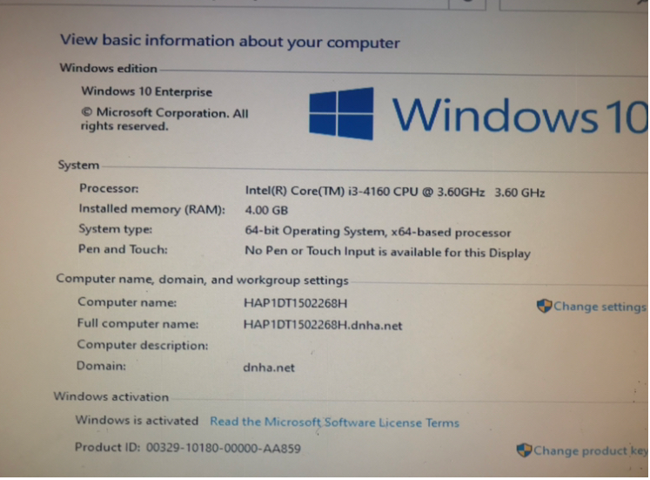
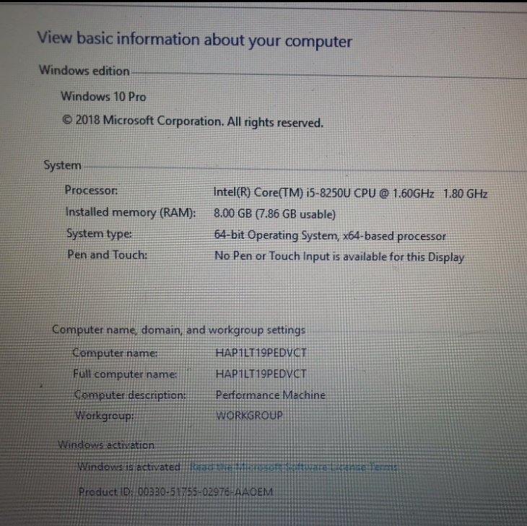
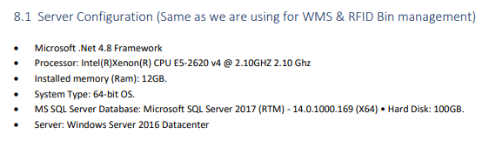
Existing PC specifications
Washing Machine PC
Performance Machine Laptop
Server specifications

